Slide 1
Module 10
OSPF Overview and Configuration
Notes:
This is the Module Title Page for Module 10 – OSPF Overview and Configuration

Slide 2
Module Objectives
Define OSPF as a routing protocol
Describe how to build OSPF Networks
Define OSPF areas, router types and virtual Links
Describe how OSPF Operates
Define LSA, LSDB, Initial synchronization, database exchange & reliable flooding
Describe OSPF Configuration and Examples
Lab Exercises
Summary
Notes:
The module objectives that need to be accomplished are described above.

Slide 3
OSPF Defined
Dynamic Routing Protocol
  It is an interior gateway protocol (IGP) that is more efficient than RIP.
    Consumes fewer network resources
    Highly scalable
    Faster convergence
    A more descriptive routing metric
    Route load sharing
    Greater security
Link State Type of Protocol
  Employs a distributed database model
Notes:
OSPF is a dynamic routing protocol. It quickly detects topological changes in the AS (such as router interface failures) and calculates new loop-free routes after a period of convergence. This period of convergence is short and involves a minimum of routing traffic.
OSPF is a link-state routing protocol that distributes routing information between routers belonging to a single IP domain, also known as an autonomous system (AS). In a link-state routing protocol, each router maintains a database describing the topology of the autonomous system. Each participating router has an identical database maintained from the perspective of that router.
From the link-state database (LSDB), each router constructs a tree of shortest paths, using itself as a root. The shortest path tree provides the route to each destination in the autonomous system. When several equal-cost routes to a destination exist, traffic can be distributed among them. The cost of a route is described by a single metric.
From RFC2178 - Abstract: :OSPF recalculates routes quickly in the face of topological changes, utilizing a minimum of routing protocol traffic. OSPF provides support for equal-cost multi-path. An area routing capability is provided, enabling an additional level of routing protection and a reduction in routing protocol traffic. In addition, all OSPF routing protocol exchanges are authenticated.

Slide 4
OSPF as a Link-State Protocol
Employs a distributed database model
Uses a single synchronized database (LSDB) for collecting link state advertisements (LSA)
  The Routing Table is derived from the LSDB
  Utilize a shortest-path first algorithm
Each OSPF router advertises a description of its local environment thru exchange of LSAs, i.e.
  router’s interfaces
  costs
  neighbor information
Notes:
Link-state protocols employ a distributed database model. Each router advertises a description of its local environment -- interfaces, costs, and neighbor information. The advertisements are collected into a single, synchronized database from which the routing table is derived using a shortest-path first algorithm.

Slide 5
Building OSPF Networks
OSPF Network Types
OSPF Routing Hierarchy
OSPF Areas
OSPF Types of Routers
Concept of Virtual Links
Notes:
Now, we are going to look into building OSPF networks

Slide 6
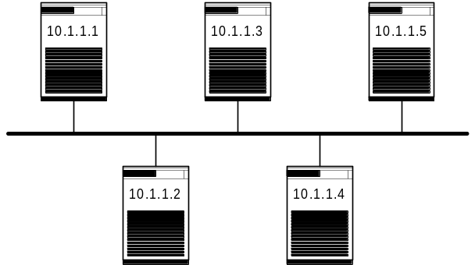
OSPF Network Types
Point-to-Point networks
  Serial lines
Non-broadcast Multi-access (NBMA) networks
  X.25, ATM
Point-to-Multipoint networks
  Frame Relay
Broadcast networks
  The only type supported by Extreme
Notes:
OSPF or some form of OSPF is used by a number of wide area network vendors. The two key attributes are scalability and lower inter-nodal update traffic.
Point-to-Point networks: Serial lines
Non-broadcast Multiaccess (NBMA) networks: X.25, ATM
Point-to-Multipoint networks: Frame Relay
Broadcast networks: Networks supporting many (more than two) attached routers, together with the capability to address a single physical message to all of the attached routers (broadcast).
Extreme only supports broadcast networks because we are an Ethernet switch.

Slide 7
OSPF Routing Hierarchy
OSPF implements a two-level hierarchical routing scheme
  Autonomous System (AS)
  Areas within an AS
Allows you to save on
  router memory consumed by the routing table
  router resources when computing the routing table
  link bandwidth when distributing routing data
Notes:
Hierarchical Routing
A technique used when building large networks
Saves router memory consumed by the routing table.
Saves router resources when computing the routing table.
Saves link bandwidth when distributing routing data.
OSPF can operate within a hierarchy; not so RIP. The largest entity within the hierarchy is the Autonomous system (AS). An AS is a collection of networks under a common administration and sharing a common strategy.
The term “Domain” is frequently used interchangeably with “Autonomous System” (AS).
OSPF implements a two-level hierarchical routing scheme through the deployment of OSPF areas

Slide 8
What is an Autonomous System?
A collection of routers and networks that fall under a single technical administration or organization
  They cooperate closely to propagate network reachability and routing information
Extreme has support for one Autonomous System
AS100
ACME Company
Notes:
The classic definition of an Autonomous System is a set of routers under a single technical administration, using an interior gateway protocol and common metrics to route packets within the AS, and using an exterior gateway protocol to route packets to other ASs.
To the outside world, the whole AS is viewed as one single entity. Each AS has an identifying number, which is assigned to it by an Internet Registry or provider. Routing information between ASs is exchanged via an exterior gateway protocol such as BGP4.
Since this classic definition was developed, it has become common for a single AS to use several interior gateway protocols and sometimes several sets of metrics within an AS.
The use of the term Autonomous System here stresses the fact that, even when multiple IGPs and metrics are used, the administration of an AS appears to other ASs to have a single coherent interior routing plan and presents a consistent picture of what destinations are reachable through it.

Slide 9
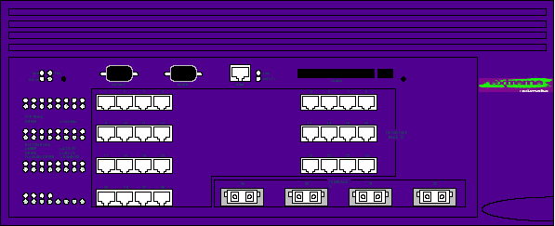
OSPF Areas
Maintains the OSPF hierarchy through its deployment within an AS
Each consists of a collection of one or more network segments interconnected by routers
Are each identified by a 32-bit Area ID
  Example: Area 0.0.0.0 ; Area 11.11.11.11
Maintain its own link state database (LSDB)
  Contains LSAs that describe the area’s topology
Routing within an area is flat.
AS100
Area 0
Area 1
Area 2
Notes:
The OSPF hierarchy is maintained through the deployment of OSPF areas.
Each OSPF area is identified by a 32-bit Area ID. (This is same size as an IP address but is not an IP address, do not be confused as this is a very common error). <====
Each area consists of a collection of one or more network segments interconnected by routers.
Every area has its own link-state database consisting of router-LSAs and network-LSAs describing how the area’s routers and segments are connected.
Routing with an area is flat.
Q1:How many LSAs are in a router’s LSDB in an area with other routers?
It should be the same as all other routers in the area.
Q2: What is the significance that in an area, all routers have the same number of LSAs in their LSDB? -
They all know about everything in the area.

Slide 10
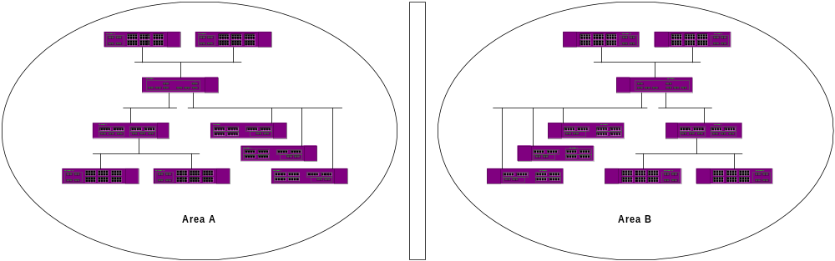
Area Topology
Detailed knowledge of area’s topology is hidden from all other areas in the parent AS
Router link state advertisement in an area are not flooded beyond the area’s borders
Area “A” does not know the internal topology of Area “B” and vice versa.
Notes:
If you want to connect an area with another area, use an ABR – Area Border Router, that will have an interface in both areas, so the link state advertisements can be propagated and all the routers in both areas would know

Slide 11
Types of OSPF Areas
Normal Area
  Area 0 (Backbone)
Stub Areas
Not-So-Stubby-Areas (NSSA)
Virtual Links
Notes:
OSPF allows parts of a network to be grouped together into areas. The topology within an area is hidden from the rest of the autonomous system.Hiding this information enables a significant reduction in LSA traffic, and reduces the computations needed to maintain the LSDB. Routing within the area is determined only by the topology of the area.

Slide 12
Normal Area
An area which is not a:
  Stub area
  NSSA
Can be placed anywhere within the OSPF routing domain
Support ASBRs
Support Virtual Links
Can distribute external routes
Notes:
A normal area is an area that is not any of the following:
Stub area
NSSA (Not-So-Stubby-Areas)
Virtual links can be configured through normal areas. External routes can be distributed into normal areas.

Slide 13
Area 0 (Backbone)
First OSPF Area created and is a normal area
Only one exist per autonomous system (AS)
Responsible for distributing routing information between areas
Consist of
  all area border routers
  networks not contained in any other area and their attached routers
Has an Area ID of 0.0.0.0
All ABRs are required to attach directly to the OSPF backbone area
Notes:
Any OSPF network that contains more than one area is required to have an area configured as area ), also called the backbone. All areas in an autonomous system (AS) must be connected to the backbone. When designing networks, you should start with area 0, and then expand into other areas.
The backbone allows summary information to be exchanged between ABRs. Every ABR hears the area summaries from all other ABRs. The ABR then forms a picture of the distance to all networks outside of its area by examining the collected advertisements, and adding in the backbone distance to each advertising router.
When a VLAN is configured to run OSPF, by default it is automatically joined to the backbone area (0.0.0.0). If you want to configure the VLAN to be part of a different OSPF area, use the CLI command:
config ospf vlan <name> area <areaid>
If this is the first instance of the OSPF area being used, you must create the area first, using the following CLI command:
create ospf area <areaid>

Slide 14
Stub Area
For routers with limited resources
  reduce memory and computation requirements
The LSDB is kept as small as possible
External route information is not distributed
  Will use default routes to ABRs instead
Does not support ASBRs
Does not support virtual links
Appears to lie on the edge of an OSPF domain (AS) in configuration
Notes:
OSPF allows certain areas to be configured as "stub areas". A stub area is connected to only one other area. The area that connects to a stub area can be the backbone area. External route information is not distributed into stub areas. Stub areas are used to reduce memory and computation requirements on OSPF routers.
AS-external-LSAs are not flooded into/throughout stub areas; routing to AS external destinations in these areas is based on a (per-area) default only. This reduces the link-state database size, and therefore the memory requirements, for a stub area's internal routers.
In order to take advantage of the OSPF stub area support, default routing must be used in the stub area. This is accomplished as follows. One or more of the stub area's area border routers must advertise a default route into the stub area via summary-LSAs. These summary defaults are flooded throughout the stub area, but no further. (For this reason these defaults pertain only to the particular stub area). These summary default routes will be used for any destination that is not explicitly reachable by an intra-area or inter-area path (i.e., AS external destinations).
An area can be configured as a stub when there is a single exit point from the area, or when the choice of exit point need not be made on a per-external-destination basis.
The OSPF protocol ensures that all routers belonging to an area agree on whether the area has been configured as a stub. This guarantees that no confusion will arise in the flooding of AS-external-LSAs.
There are a couple of restrictions on the use of stub areas. Virtual links cannot be configured through stub areas. In addition, AS boundary routers cannot be placed internal to stub areas.

Slide 15
Not-So-Stubby-Area (NSSA)
Similar to existing OSPF Stub Area with two additional capabilities
  External routes originating from ASBR connect- ed to NSSA can be advertised within
  External routes originating from NSSA can be propagated to other areas, including the backbone.
Notes:
NSSAs are similar to the existing OSPF stub area configuration option, but have the following two additional capabilities:
External routes originating from an ASBR connected to the NSSA can be advertised within the NSSA
External routes originating from the NSSA can be propagated to other areas, including the backbone area.

Slide 16
OSPF Defines Three Types Of Routers
Internal Router (IR)
  Has all of its interfaces within the same area
  Can be further divided into the following router types
    DR – Designated Router
    BDR – Backup Designated Router
    ODR – Other Designated Router
Area Border Router (ABR)
Autonomous System Boundary Router (ASBR)
Notes:
We were talking of the OSPF hierarchy, defining areas and now we will define OSPF three types of routers.
Internal Router (IR)
Has all of its interfaces within the same area
Area Border Router (ABR)
Has interfaces in multiple areas
Responsible for exchanging summary advertisements with other ABRs
Autonomous System Boundary Router (ASBR)
Acts as a gateway between OSPF and other routing protocols, or other autonomous systems

Slide 17
Internal Routers
OSPF routers having all of its interfaces inside a single area
Can have different type of functions based on an election algorithm:
  DR – Designated Router
  BDR – Backup Designated Router
  ODR – Other Designated Router
Area 0

Slide 18
Internal Router
DR - Designated Router & BDR – Backup DR
One DR for every broadcast network in an area
  First router up in a broadcast network is the DR
One BDR to backup the DR per network in an area
  Second router up in a broadcast network becomes the BDR
All neighboring OSPF routers will exchange LSAs with the DR & BDR of a network segment
  This allows router LSDB synchronization between them
  It also reduces the amount of traffic otherwise consumed by routing protocol traffic to each router.
Notes:
OSPF routers exchange link state information with their adjacent neighbors. Because broadcast networks may have many routers, a great deal of bandwidth can be consumed by the routing protocol traffic.
To reduce this amount of traffic, every broadcast network has a Designated Router (DR) and a Backup Designated Router (BDR). Each router on the network exchanges link state information (synchronizes databases and forms an adjacency) only with the DR and BDR.
The BDR takes the place of the DR in the event of a failure.
DR will then generate an LSA LS Type 2 - Network-LSAs that
Describes a network segment - along with the IDs of all currently attached routers.
Propagate it to all routers in the network segment
If DR fails, BDR takes over the DR role
If a BDR fails,
OSPF router with highest Router Priority will replace the BDR
More than 2 routers with same Router priority?
OSPF Router ID will break the tie – higher ID wins

Slide 19
Example Single Area Topology
Internal Routers
DR
ODR
Net 10
ODR
DR
BDR
Net 20
ODR
BDR
DR
BDR
Net 30
Notes:
The diagram shows all the different types of internal routers within a single area.
All routers will send their link state advertisements to the DR or the network segment
they connect to.

Slide 20
Area Border Router (ABR)
An OSPF router attached to two or more areas
  It runs multiple copies of the basic algorithm
  Manages inter-area communication
Maintain an LSDBs for each attached area and an additional copy for the backbone
Responsible for condensing the areas topology information into an LSA Type 3: Summary-LSAs for distribution to the backbone.
  The backbone in turn distributes the information to the other areas.
As an ABR, an Extreme switch supports 8 areas
Notes:
Inter-area communication is managed by the Area Border Router (ABR).
An ABR attaches to two or more areas, running multiple copies of the basic algorithm.
ABRs maintain link-state databases for each attached area and an additional copy for the backbone.
ABRs condense the topological information of their attached areas into Summary-LSAs for distribution to the backbone. The backbone in turn distributes the information to the other areas.
Where possible, Area Border Routers can be configured to aggregate some or all of the networks within its dependent area into a single, summary network address with a less-discreet network mask.
We will talk about LSA Types and Type 3 later on.

Slide 21
ASBR – AS Boundary Router
An OSPF router that connects to two or more autonomous systems (AS)
ASBR
RIP Cloud
ASBR
ASBR
ABR
AS444
Area 0
Area 1

Slide 22
Concept of Virtual Links
Used when a new ABR is introduced that does not have a direct physical attachment to the backbone
  Recommended only as an interim solution
Provides a logical path between the ABR of the disconnected area and the backbone (Area 0)
  It is established between two ABRs having a common area, provided that one of the ABR is connected to Area 0
Area 2
Area 1
Area 0
Area 3 (newly added ABR & area)
create Virtual Links
Notes:
OSPF requires that all areas attach directly to the backbone area but not that the attachment be physical.
Virtual links will tunnel the summary-LSAs across non-backbone areas, logically maintaining the desired hub and spoke topology for inter-area routing exchange.
Inter-area traffic does not have to transverse the backbone area if the destination area has a shorter path.
In the situation when a new area is introduced that does have a direct physical attachment to the backbone, a virtual link is used. A virtual link provides a logical path between the ABR of the disconnected area and the ABR of the normal area that connects to the backbone. A virtual link must be established between two ABRs that have a common area, with one ABR connected to the backbone.

Slide 23
Exercise – Identify OSPF Components
INTERNET
Area 4
Area 0
R4
R3
R2
R1
R2
R1
Area 2
R3
R0
R2
R1
R1
R1
R3
R3
R2
R2
RIP Cloud
Area 3
Area 1
AS-555 of XYZ Company
Notes:
Identify the different area and router types in the network topology presented above.
What does the clouds represent?
What possible types of areas can A0 – A4 be?
Which area can be Normal, Stub, NSSA?
Do you find anything in the topology that needs to have a virtual link?
What are the different types of routers that you find per area?
Which are identified as Internal Routers, ABR, ASBR ?

Slide 24
How OSPF Operates Newly Configured OSPF Router’s Perspective
- Neighbor Discovery & Hello Packet exchange
2 - Initialize LSDB via LSA Exchange
3 - Synchronize LSDBs and update LSAs through Reliable Flooding
4 - Calculate and build the OSPF Routing table
5 - Forwarding and Routing Occurs
Notes:
To understand OSPF operations, let us look at a newly configured OSPF router’s perspective, when joining an
OSPF network for the first time, the router will undergo several stages prior to actually
participating in forwading/routing of packets.
Basic Features of OSPF
Hello Packets
Link State Advertisements (LSA)
Link State Database (LSDB)
Reliable Flooding
Shortest Path First Routing Calculations
Areas and Inter-area Routing

Slide 25
1 - OSPF Router Neighbor Discovery Hello Packet
Hello packets are sent out on all router’s interfaces to advertise itself to other routers every 10 seconds by default.
A router learns about its neighbors when it receives neighbor router’s Hello packet
Once router neighbors are discovered, subsequent Hello packet within 40 seconds
  Otherwise, it will terminate neighbor relationship
R4
R2
Hello
R1
Hello
R3
Notes:
A router discovers neighbors by sending OSPF Hello packets out all of its interfaces.
By default, a router sends Hellos out an interface every 10 seconds.
A router learns the existence of a neighboring router when it receives the neighbor’s OSPF Hello in return.
Take R1 in the diagram, if R1 initially just came up, it will send out its Hello packet to both its interfaces in the hopes of receiving a hello back from R2, R3 and R4.
Failure is detected when a router does not receive a Hello from a neighbor within 40 seconds.
“Detecting neighbor failures in a timely fashion is crucial to OSPF protocol performance.”
The Hello protocol ensures that neighbor routers agree on timing parameters and can aid in link failure detection. A fault is usually detected way before this time, however, by the data-link protocol since the absence of Hello packets is most likely caused by an interface going down.

Slide 26
OSPF Hello Packets cont…
Recognized only by routers attached to the same subnet and subnet mask
In a broadcast environment, the Hello contains OSPF router IDs of all discovered neighbor routers and information on parameters for Hello Interval and Router Dead Interval
  For use by neighbor routers to agree on communication variables
  Allows occurrence of occasional lost Hello packet and not be interpreted as a link down condition.
  Reduces overhead of sending multiple Hellos
Notes:
Moy: “Detecting neighbor failures in a timely fashion is crucial to OSPF protocol performance.”
The Hello protocol ensures that neighbor routers agree on timing parameters and can aid in link failure detection. A fault is usually detected way before this time, however, by the data-link protocol since the absence of Hello packets is most likely caused by an interface going down.

Slide 27
OSPF Hello Packets cont…
Ensure that the OSPF link is bi-directional
  An OSPF router will not forward data packets over a unidirectional link.
R4
R2
R4-Hello
R1-Hello
R1
R2-Hello
R3-Hello
R1-Hello
R3
Notes:
In a broadcast environment, a Hello packet contains the OSPF router IDs of all the routers the sender has heard up to the point of transmission. This reduces the overhead of sending multiple Hellos -- one to each neighbor -- by including all of the information in a single packet.
Hello packets ensure that the OSPF link is bi-directional. An OSPF router will not forward data packets over a unidirectional link.

Slide 28
Link State Advertisement (LSA)
Are transmitted by every OSPF router when neighbor adjacency is established
  LSAs vary according to Link State Types and router function/s
Describes a router’s local piece of the routing topology that it is responsible for
A router’s self-originating LSA is re-transmitted every 30 minutes
  even in the absence of any change, in the event the LSA information may have been lost or corrupted in a neighbor router’s tables.
Stored in the router’s link state database (LSDB)
Notes:
Each OSPF router is responsible for describing its local piece of the routing topology through the transmission of link-state advertisements.
LSAs describe the local state of a router or network. This includes the state of the router's interfaces and adjacencies. Each link state advertisement is flooded throughout the routing domain.
Every thirty minutes a router will -- even in the absence of any change -- re-broadcast/retransmit this self-originating data in the event it may have been lost or corrupted in a neighbor router’s tables.

Slide 29
LSA Link State Types
Type Number Description
1 Router-LSA
2 Network-LSA
3 Summary-LSA (IP network)
4 Summary-LSA (ASBR)
5 AS external-LSA
6 Group-Membership-LSA (MOSPF)
7 NSSA external-LSA
8 External-attributes LSA (BGP)
NOTE: LSA Type 6 and 8 are currently not Extreme supported
Notes:
LSA LS Type 1 - Router-LSAs is Generated by every OSPF router
Describes the router’s set of active interfaces, its associated cost and any neighbor information
Flooded throughout a single area only. Link State ID = is the router’s OSPF Router ID
LSA LS Type 2 - Network-LSAs is generated by OSPF Designated Routers (DRs)
Describes a network segment - i.e., broadcast domain along with the IDs of all currently attached routers. Link State ID field lists the IP interface address of the DR
LSA LS Type 3 - Summary-LSAs (IP Network) This originate from ABRs
Supports hierarchical routing through the use of OSPF areas. Link State ID field is an IP network number. Type 3 summary-LSAs (IP network( are used when the destination is an IP Network. In this case the LSA’s Link State ID field is an IP network number (if necessary, the Link State ID can also have one or more of the network’s “host” bits set.
LSA LS Type 4 summary-LSA is used when the destination is an AS boundary router and the Link State ID field is the AS boundary router’s OSPF Router ID.
LSA LS Type 5 - Originated by an ASBR and it describes destinations external to the AS. Link State ID field specify an IP network number
LSA LS Type 7 Functionally identical to an LS Type 5 for a Normal Area and
Allows the importation of external routes normally not advertised out of the Not So Stubby Area (NSSA). Destined for ABRs with highest Router ID

Slide 30
LSDB Initial Synchronization
When two neighbors first start communicating, they must synchronize their databases before forwarding traffic over their shared link to prevent routing loops from occurring.
Switch A
Switch B
Synchronize Databases
LSDB-A
LSDB-B
Notes:
Database synchronization in a link state protocol is crucial. Like wide area switches synchronization protects the network as a whole from corrupt information. Of the 5 OSPF protocol packet types, 4 are used for database synchronization with the Hello packet being the 5th type as follows:
Link State Request packet
Link State Update packet
LS Acknowledge packet
Database Description packet

Slide 31
2 – Initialize LSDB - LSA Exchange
With neighbor adjacency established, routers will exchange LSAs and store them in their LSDBs
R4
R2
R4-LSA
R1-LSA
R1
R2-LSA
R3-LSA
R1-LSA
R3
LSDB
Notes:
The distributed database model shows that every OSPF router has a link state database known as an LSDB. Initially, the only LSA that is found in the router’s database is its own LSA.
Let us define what a Link State Advertisement (LSA) really is.

Slide 32
Link-State Database (LSDB)
The collection of all OSPF LSAs received
Each OSPF router has an identical LSDB
Gives complete description of the network:
  routers
  network segments
  interconnectivity (how it is interconnected)
LSDBs are exchanged between neighboring routers soon after routers discover each other
Maintained through a procedure called reliable flooding
Notes:
The collection of all OSPF LSAs is called the link-state database.
Each OSPF router has an identical link-state database and it gives a complete description of the network including the routers, the network segments, and how they are interconnected.
Link-state databases are exchanged between neighboring routers soon after the routers have discovered each other.
The link state databases are maintained through a procedure called reliable flooding.
Upon initialization, each router transmits a link-state advertisement (LSA) on each of its interfaces. LSAs are collected by each router and entered into the Link State Database (LSDB) of each router. OSPF uses flooding to distribute LSAs between routers. Any change in routing information is sent to all of the routers in the network. All routers within an area have the exact same LSDB.

Slide 33
3 – LSDB Synchronization
When all router LSDB contains identical LSAs, they are said to be fully synchronized
In this example: What will be the contents in each of LSDB if all of them are fully synchronized?
R4
R2
R4-LSA
R1-LSA
R1
R2-LSA
R3-LSA
R1-LSA
R3
LSDB
Notes:
When a new router comes up, he synchronizes only with the DR. How does it know he is communicating to a DR? Because this router destine its packet to 224.0.0.6 - which is the multicast address for All Drouters.
An OSPF router will send its Link State Update (LSU) to the DR and BDR
The destination IP address for the LSU will be multicast address 224.0.0.6 (All DRouters).
The DR will then flood the update to all OSPF routers
The destination IP address for the LSU will be multicast address 224.0.0.5 (All OSPFRouters).
Procedure used by the routers to synchronize their databases once the hello protocol determines a bi-directional connection between router neighbors.
During synchronization, the neighbor routers do three things:
Forward current LSA headers
Compares the header received to the LSDB
Request the full LSA for new or newer headers

Slide 34
LSA Updates for OSPF Database Using Reliable Flooding
LSA Updates are periodically generated by a router wishing to update a self-originated LSA because:
  The router’s local state may have changed
  The router wants to delete one of its self-originated LSAs
Used to propagate LSA Updates throughout the routing domain
Updates are forwarded out all router interfaces
Notes:
LSA Updates are periodically generated by a router wishing to update a self-originated LSA:
The router’s local state may have changed
The router wants to delete one of its self-originated LSAs
What happens in RELIABLE FLOODING:
Updated LSAs are propogated throughout the routing domain via Reliable Flooding.
A router will generate a Link-state Update packet containing one or more LSAs
Update is forwarded out all interfaces.
Neighbor router receives the Update and compares the LSAs with the LSDB
More recent LSAs are installed in LSDB
Acknowledgement is sent back to originating route
New Link-state Update containing the LSA is sent out all interfaces except receiving one.

Slide 35
4 - OSPF Routing Calculations
With router LSDBs synchronized for all routers in routing domain
  The router will use Dijkstra’s Shortest Path First algorithm
    This allows calculation of shortest paths to all destinations
Routing table is constructed from the calculations and includes
  network destinations
  associated costs
Notes:
Continuing from the previous slide, as reliable flooding is accomplished, the OSPF Routing Calculations follows:
Once all routers in the routing domain have synchronized link state databases, the router will use Dijkstra’s Shortest Path First algorithm to calculate the shortest paths to all destinations.
A routing table will be constructed from this information complete with network destinations and their associated costs.
RFC 1583 - OSPF Version 2 for more detail on Dijkstra’s SPF.
OSPF link costs are arbitrary and have only three restrictions:
1) 1<= link cost <= 65,535
2) More preferred links have smaller cost
3) Costs are additive
Every link in the switch has an associated costs.

Slide 36
5 – OSPF Routing Occurs
After all OSPF routers established neighbor adjacency, and
Routers’ LSDBs are fully synchronized, and
Routers’ Routing Tables are constructed

Slide 37
Prior to OSPF Configuration Things to Consider
Assign a unique router ID for each switch
  The router_ID is one of the IP addresses assigned to one of the switch interfaces (VLAN)
It is recommended to manually set each OSPF switch’s router ID to:
  simplify router management
  prevent corruption of virtual links (if applicable)
Do not use 0.0.0.0 as a router ID
  0.0.0.0 is used as Area 0’s Area ID
Notes:
Each switch that is configured to run OSPF must have a unique router ID.
It is recommended that you manually set the router ID of the switches participating in OSPF, instead of having the switch automatically choose its router ID based on the highest interface IP address. Not performing this configuration in a larger, dynamic environments could result in an older link state database remaining in use.
CAUTION: Do not set the router ID to 0.0.0.0
To configure OSPF for the Extreme switch, you need to learn about the CLI commands following next.

Slide 38
OSPF Configuration Steps
Configure the router_ID for non-automatic
  config ospf routerid <router identifier>
Create additional OSPF areas as required
  create ospf area <area_id>
Configure VLANs for OSPF and assign the area
  config ospf vlan add <vlan_name> area <area ID>
Enable OSPF globally on the switch
  enable ospf
Verify configured OSPF parameters
  show ospf
Notes:
Before configuring the switch for OSPF operations, it is assumed that the following steps have already been done:
Physical cabling for the router connectivity has been done and verified.
The VLANs (router interfaces) for each switch/router has already been created and configured with ports and ipaddress/mask
create vlan <vlan_name>
config vlan <vlan_name> add ports <port_list>
config vlan <vlan_name> ipaddress <ip_addr>
Routing (IP Forwarding) has already been enabled for all OSPF VLANs
enable ipforwarding

Slide 39
CLI Command – configure OSPF
* Summit1iTx:76 # con ospf <tab>
Next possible completions:
add area asbr-filter ase-limit ase-summary
delete direct-filter lsa-batch-interval metric-table routerid spf-hold-time virtual-link vlan <vlan name>
* Summit1iTx:76 #
Notes:
The CLI Command “configure ospf” options will be discussed as we move forward in this module, one at a time as appropriate. The display is taken from ExtremeWare software release 6.1.7b9.

Slide 40
Basic OSPF CLI Commands
config ospf routerid
create ospf area
  delete ospf area
config ospf add vlan area
  config ospf delete vlan
enable ospf
  disable ospf
show ospf

Slide 41
CLI Command - config ospf routerid
config ospf routerid [automatic | <routerid>]
  Configures the OSPF router ID.
  If automatic is specified, the switch uses the largest IP interface address since OSPF was enable as the OSPF router ID.
  The default setting is automatic.
Notes:
It is highly recommended that you configure the routerid manually by assigning an IP address of our of the router’s interfaces.

Slide 42
CLI Command - create/del ospf area
create ospf area <areaid>
delete ospf area [<areaid> | all]
  Create or delete an OSPF area. Area 0.0.0.0 does not need to be created. It exists by default. It also cannot be deleted.
  Once an OSPF area is removed, the associated OSPF area and OSPF interface information will also be removed.

Slide 43
CLI Command - config ospf add/del vlan
config ospf add vlan [<name> | all] area <area identifier>
config ospf delete vlan [<vlan_name> | all]
  Enables or disables OSPF on one or all VLANs (router interfaces). The <area identifier> specifies the area to which the VLAN is assigned.
  The default setting is disabled.

Slide 44
CLI Command - enable/disable ospf
enable ospf
disable ospf
  Enable or disable OSPF processing in the router. Default is disabled.
Notes:
Enable and disable ospf is a global command for the switch.
Note that in EW2.0 the user will need to pick between OSPF and RIP. Only one of the two protocols can be enabled.

Slide 45
CLI Command - show ospf
show ospf [ area ase-summary interfaces lsdb virtual-link ] <cr>
  Displays global OSPF information. If the following is specified:
    AREA: Displays information about a particular OSPF area, or all OSPF areas.
    ASE-SUMMARY: Displays the OSPF external route aggregation configuration
    INTERFACES: Displays information about one or all OSPF interfaces
    LSDB: Displays current LSDB table.
    VIRTUAL LINK: Displays virtual link information about a specified router/s
Notes:
SHOW OSPF AREA
Display the OSPF area information. If no argument is specified, then all the OSPF areas will be shown:
Area ID, Area Type (stub or normal), and Router ID
Number of SPF executions, number of ABRs known, number of ASBRs known, number of LSAs in LSDB, and the LSA checksum.
List of router interfaces (VLANs), their OSPF state, the link state, and the router ID for the DR and BDR.
Configured address ranges, if any.

Slide 46
Example: show ospf
* Summit1iTx:4 # show ospf
Router Id OSPF ASBR ABR ExtLSA ExtLSACsum OrigNewLSA RxNewLSA SpfHoldTime
10.10.10.1 D NO NO 0 0x0 0 0 3
RouterId Selection: User Configured
Export Static: Disabled
Export Rip: Disabled
Export Direct: Disabled
Export EBGP: Disabled
Export IBGP: Disabled
Export Vip: Disabled
Originate Default: Disabled
ASBR route Filter: None
Direct route Filter: None
10M Cost = 10, 100M Cost = 5,1G Cost = 4.
Lsa Batch Interval = 30.
AS-external LSA limit: disabled Timeout: disabled Current count: 0
* Summit1iTx:5 #
Notes:
Example display running EW 4.0. Additional of 3 new lines in the display has been added from EW 2.0. These are:
Export Static
Export rip
ASBR route Filter

Slide 47
Lab17 – OSPF Configuration I
Configuring Routers for OSPF
Create and configure 6 Extreme switches
  Use the network topology shown in the diagram
Be familiar with the CLI commands:
  config ospf routerid
  create ospf area
  config ospf add vlan area
  enable ospf
  show ospf

Slide 48
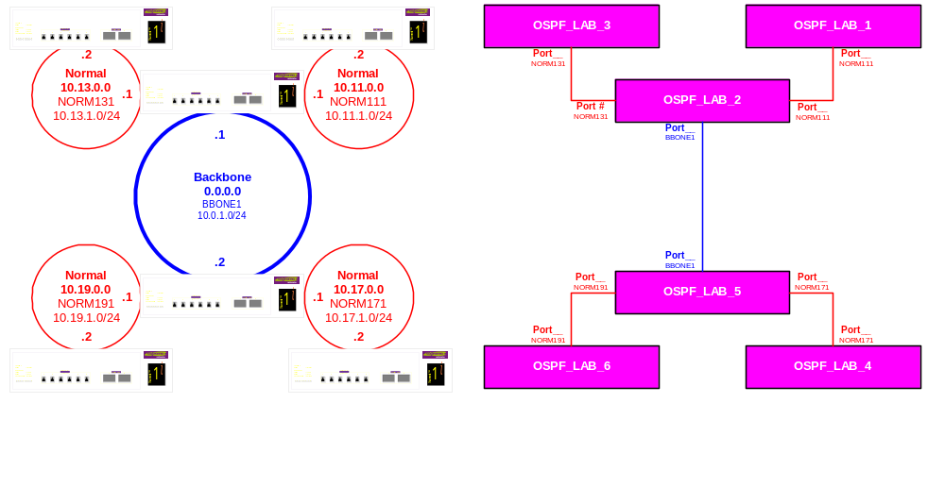
Lab17 – OSPF Config I Topology

Slide 49
Configuring OSPF Virtual Links
config ospf add virtual-link
  config ospf delete virtual-link
show ospf virtual-link
Notes:
Continuing with more OSPF Configuration, the above are the commands for configuring virtual-links on Extreme switches.
Virtual links are considered an interim solution to an existing network setup. When a router is to become an ABR for a newly created area and that ABR does not have a direct connection the the Area 0, one utilizes a virtual link. It is configured on the ABR which has a direct connection to area 0 and the ABR that does not have any link to Area 0 yet has an interface to the new area created. There must be a common area shared between these two ABRs that are to be configured with virtual links, known as the transit area. This transit area cannot be the backbone area.
The ABR virtual link routerid must point to the routerid of the neighbor ABR with a link to the Area0 and vice versa.

Slide 50
CLI Command - config ospf add virtual-link
config ospf add virtual-link <routerid> <areaid>
config ospf delete virtual-link <routerid> <areaid>
  Adds or deletes a virtual link connected to another area border router (ABR).
  Specify the following:
    routerid -- Far-end router ID.
    Areaid -- Transit area used for connecting the two end-points. The transit area cannot be the backbone (0.0.0.0).
Notes:
Adds a virtual link connected to another ABR
Specify the following:
routerid - Far-end router interface number
areaid - Transit area used for connecting the two end-points. The transit area cannot have the IP address of the backbone, 0.0.0.0.
Note: A virtual link cannot be configured through a stub area.

Slide 51
CLI Command - show ospf virtual-link
show ospf virtual-link <routerid> <cr>
Displays virtual link information about a particular router or all routers. Default display is for all.
Notes:
Display the virtual-link configuration and operation information. Default is all:
Area ID and neighbor router ID
Receive interval, transit delay, Hello interval, and dead interval.
Authentication configuration
Virtual link type and number of events
Neighbor router ID, IP address, and priority
Link state, DR ID, BDR ID, and dead time

Slide 52
Lab18 – OSPF Configuration II
Configuring Virtual Links
Building on Lab17, configure virtual links using the network topology provided
Familiarization on the CLI commands
  config ospf add virtual-link
  show ospf virtual-link

Slide 53
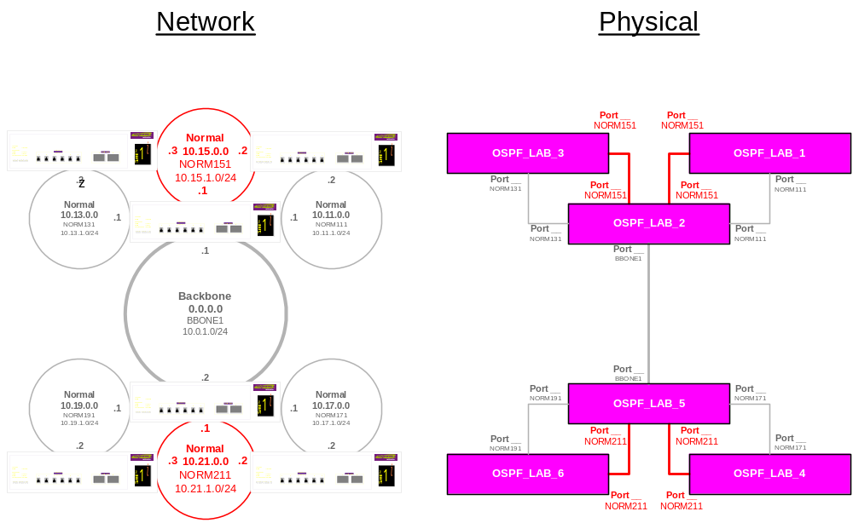
Lab18- OSPF Config II Topology (1)
Notes:
We create a new Area from the previous lab. Before, it was okay, and with a new area, the network collapses.
Switches 2 and 5 are not performing the functions as the four corner switches. The configurations for SW2 and SW5 are completely different that the rest.

Slide 54
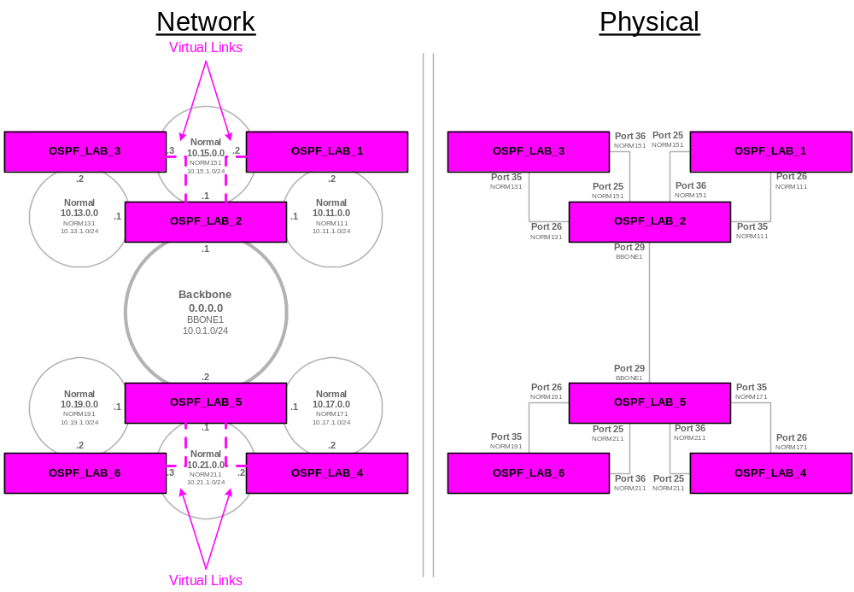
Lab18 - Network Topology 2 Configuring Virtual Links as shown

Slide 55
Configuring OSPF Areas
config ospf area <area_id>
  [ add | authentication | cost | delete | external-filter | interarea-filter | normal | nssa | priority | stub | timer ]
config ospf area <area_id>
  [ add | authentication | cost | delete | external-filter | interarea-filter | normal | nssa | priority | stub | timer ]
show ospf area detail
Notes:
The CLI command “configure ospf area” presents the options as follows
config ospf area <area_id> [ add | authentication | cost | delete | external-filter | interarea-filter | normal | nssa | priority | stub | timer ]
It is intended to cover the following high-lighted options only.

Slide 56
CLI Command - config ospf area normal
config ospf area <areaid> normal
  Configure an OSPF area as a normal area
  Default area type is normal
  Area 0.0.0.0 can only be normal
Notes:
NSSA is not supported in EW2.0 but is now supported in EW 4.0

Slide 57
CLI Command - config ospf area stub
config ospf area <areaid> stub [summary | nosummary] stub-default-cost <cost>
  Configures an OSPF area as a stub area.
  Stub-default-cost is the the cost of the default summary-LSA that the router should advertise into the area.
Notes:
StubDefaultCost
If the area has been configured as a stub area, and the router itself is an area border router, then the StubDefaultCost indicates the cost of the default summary-LSA that the router should advertise into the area.
Area border routers connecting to a stub area can originate summary-LSAs into the area or can choose to originate only a subset of the summary-LSAs, possibly under configuration control. The fewer LSAs originated, the smaller the stub area's link state database, further reducing the demands on its routers' resources. However, omitting LSAs may also lead to sub-optimal inter-area routing, although routing will continue to function.
In a stub area, instead of importing external routes each area border router originates a "default summary-LSA" into the area. The Link State ID for the default summary-LSA is set to DefaultDestination, and the metric set to the (per-area) configurable parameter StubDefaultCost. Note that StubDefaultCost need not be configured identically in all of the stub area's area border routers.

Slide 58
CLI Command - config ospf area nssa
config ospf area <areaid> nssa [summary | nosummary] stub-default-cost <cost> {translate}
  Configures an OSPF area as a Not-So-Stubby-Area (NSSA).
  Stub-default-cost is the the cost of the default summary-LSA that the router should advertise into the area
  Translate option:
    Determines whether type 7 LSAs are translated into type 5 LSAs.
Notes:
The CLI command to control the NSSA function is similar to the commands used for configuring the stub area, as follows:
config ospf area <areaid> nssa {summary | nosummary} stub-default-cost <cost> {translate}
The translate option determines whether type 7 LSAs are translated into type 5-LSAs. When configuring an OSPF area as an NSSA, the translate should only be used on any NSSA border routers, where translation is to be enforced. If translate is not used on any NSSA border router in an NSSA, one of the ABRs for that NSSA is elected to perform translation (as indicated in the NSSA specification). The option should not be used on NSSA internal routers. Doing so inhibits correct operation of the election algorithm.

Slide 59
Lab19 – OSPF Configuration III Creating Areas of Different Types
Building from Lab18 – create and configure different types of areas
Familiarization on using the CLI Commands:
  config ospf area normal
  config ospf area stub
  config ospf area nssa
  show ospf area detail

Slide 60
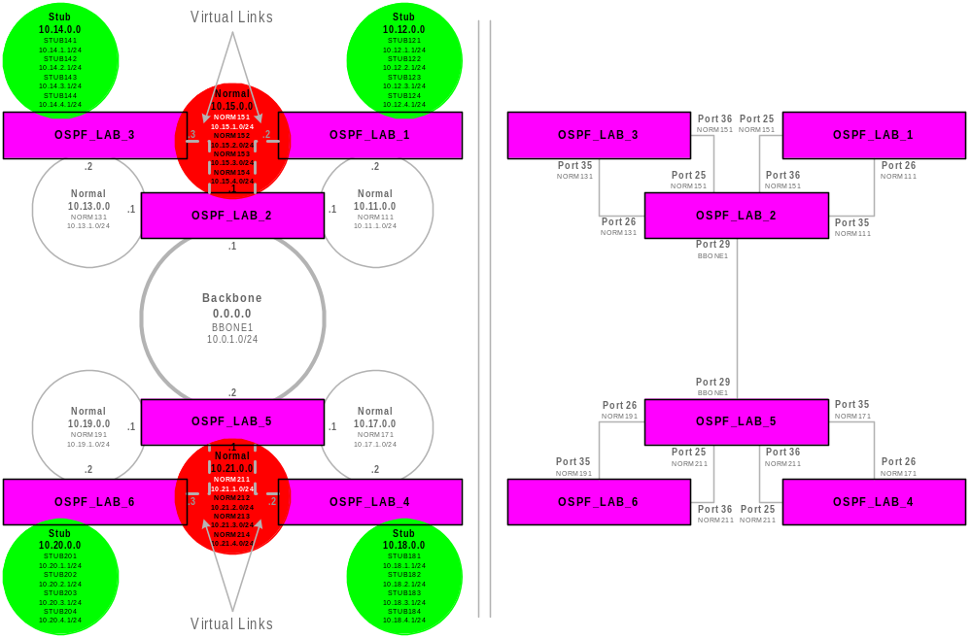
Lab19 – OSPF Config III Topology

Slide 61
CLI Command – configure ospf Review
* Summit1iTx:76 # con ospf <tab>
Next possible completions:
add area asbr-filter ase-limit ase-summary
delete direct-filter lsa-batch-interval metric- table routerid spf-hold-time virtual-link vlan <vlan name>
Summit1iTx:76 #
Options in bold have not been discussed so far.
Notes:
The CLI Command “configure ospf” options will be discussed as we move forward in this module, one at a time as appropriate. The display is taken from ExtremeWare software release 6.1.7b9.

Slide 62
More OSPF Configuration Commands
config ospf
  [asbr-filter | ase-limit | ase-summary | direct-filter | lsa-batch-interval | metric-table | spf-hold-time]
config ospf area <area_id>
  [ add | authentication | cost | delete | external-filter | interarea-filter | normal | nssa | priority | stub | timer ]
enable/disable ospf
  [ export | originate-default ]
*enable iproute sharing (ECMP)
show ospf
  [ area | ase-summary | interfaces | lsdb | virtual-link ]

Slide 63
CLI Command - config ospf spf-hold-time
config ospf spf-hold-time {<seconds>}
  Configures the minimum number of seconds between Shortest Path First (SPF) recalculations.
  The default setting is 3 seconds.

Slide 64
CLI Command - config ospf area
Authentication
config ospf area <areaid> authentication [ encrypted | md5 | none | simple-password ]
  Specifies the authentication password (up to eight characters) or Message Digest 5 (MD5) key for one interface or all interfaces in an area.
  The md5_key is a numeric value with range 0 to 65,536.
  When the OSPF area is specified, authentication information is applied to all OSPF interfaces within the area.
Notes:
Adds a virtual link connected to another ABR
Specify the following:
routerid - Far-end router interface number
areaid - Transit area used for connecting the two end-points. The transit area cannot have the IP address of the backbone, 0.0.0.0.
Note: A virtual link cannot be configured through a stub area.

Slide 65
CLI Command - config ospf area Timer
config ospf area <areaid> timer <retransmit interval> <transmit delay> <hello interval> <dead interval>
  Configures the timers for one interface or all in the same OSPF area. The following default, minimum and maximum values (in seconds) are used:
    Default Min. Max.
    Retransmission Interval 5 0 3,600
    Transmit Delay 1 0 3,600
    Hello Interval 10 1 65,535
    Dead Interval 40 1 2,147,483,647
Notes:
Adds a virtual link connected to another ABR
Specify the following:
routerid - Far-end router interface number
areaid - Transit area used for connecting the two end-points. The transit area cannot have the IP address of the backbone, 0.0.0.0.
Note: A virtual link cannot be configured through a stub area.

Slide 66
CLI Command - config ospf … cost
config ospf [vlan <name> | area <areaid> | all] cost <number>
  Configures the cost (metric) of one or all interface(s).
  The default cost of an interface is 1.
  The maximum cost is 65,535.

Slide 67
CLI Command - config ospf … priority
config ospf [vlan <name> | area <areaid> | all] priority <number>
  Configures the priority used in the designated router-election algorithm for one or all IP interface(s) or for all the interfaces within the area.
  The range is 0 - 255
  The Default priority setting is 1
  A value of 0 disqualifies the router from election
Notes:
The range is 0 to 255, and the default setting is 1. Setting the value to 0 ensures that the router is never selected as the designated router (DR) or backup designated router (BDR).

Slide 68
CLI Command - enable iproute sharing
enable iproute sharing
  Enables load sharing if multiple routes to the same destination are available, known as ECMP (equal cost multipath)
  Only paths with the same lowest cost are shared.
  The default setting is disabled.
Notes:
This allows load sharing if multiple routes to the same destination are available (equal cost multipath). Only the paths that contains the same lowest cost are shared.
NOTE: The ExtremeWare 2.0 and 4.0 user guide indicates that the default setting for this command is enabled. It is disabled.

Slide 69
CLI Command – enable ospf export
enable ospf export
[ bgp | direct | e-bgp | i-bgp | rip | static | vip ] cost {metric} [ase-type-1 | ase-type-2] {tag <number>}
disable ospf export
[ bgp | direct | e-bgp | i-bgp | rip | static | vip]
  Enable/disables the distribution of BGP, RIP, Static, Direct, VIP routes into the OSPF domain.
  The default tag number is 0.
  The default setting is disabled.
Notes:
Enables the distribution of static routes into the OSPF domain. The default tag number is 0. The default setting is disabled.

Slide 70
CLI Command - show ospf lsdb
show ospf lsdb [ area detail lsid lstype routerid
stats summary ]<cr>
  Displays a table of the current LSDB.
  The user can filter the display using either area ID, the remote router's router ID, or the link state ID.
  Default is all with no detail.
  If detail is specified, each entry includes complete LSA information

Slide 71
Example: show ospf lsdb
OSPF_LAB_2:18 # show ospf lsdb area all all
Router LSAs for area 0.0.0.0
Link State ID Adv Router Seq# Age Chksum #Links
-------------------------------------------------------------
10.10.10.10 10.10.10.10 0x8000011d 1227 0xafc6 1
20.20.20.20 20.20.20.20 0x80006754 510 0x835f 3
30.30.30.30 30.30.30.30 0x800040a9 1245 0xf018 1
40.40.40.40 40.40.40.40 0x80000169 450 0x6e4c 1
50.50.50.50 50.50.50.50 0x800001ab 1279 0x7f83 3
60.60.60.60 60.60.60.60 0x8000016c 461 0x8095 1
Network LSAs for area 0.0.0.0
Link State ID Adv Router Seq# Age Chksum
-------------------------------------------------------------
10.0.1.2 50.50.50.50 0x80000169 1273 0xb14f
Summary LSAs for area 0.0.0.0
Link State ID Adv Router Seq# Age Chksum
-------------------------------------------------------------
10.11.1.0 10.10.10.10 0x80000114 1230 0x dfc
10.11.1.0 20.20.20.20 0x8000011b 1250 0xd109
10.12.0.0 10.10.10.10 0x80000109 1018 0x22f2
10.13.1.0 20.20.20.20 0x80000194 1250 0xc698
Notes:
Shows all areas and all link types
# of Links
Seq - is the checksum
Network LSA - Type 2, the DR is 10.0.1.2
Summary LSA - Type 3 LSA
Why are there no costs and other information shown? Because this is just the header information (20-byte info.) If you want the details, then you can do configure with “detail”

Slide 72
Lab20 – OSPF Configuration IV
Still building after Lab19, configure the network based on the topology given.
Familiarization on more OSPF CLI Commands

Slide 73
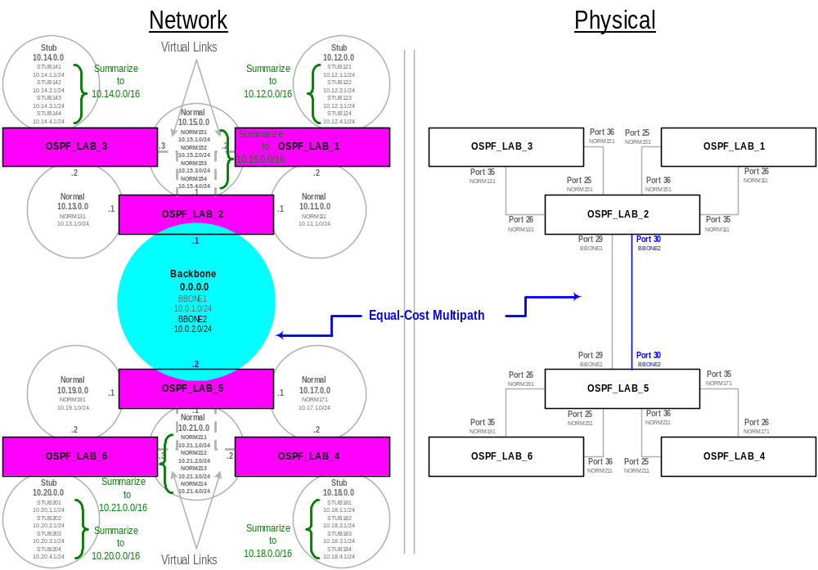
Lab 20 - Network Topology

Slide 74
Summary
Define OSPF as a routing protocol
Describe how to build OSPF Networks
Define OSPF areas, router types and virtual Links
Describe how OSPF Operates
Define LSA, LSDB, Initial synchronization, database exchange & reliable flooding
Describe OSPF Configuration and Examples
Lab Exercises
Notes:
The module objectives that need to be accomplished are described above.
LSDB - is the collection of all the LSAs. The LSDB is synchronized with all the routers in a particular area.

